Slide 1
Academic Planner
Function
Emely Callejas, Ashley Cortez, Robert Pimentel, Angelica Verduzco
BANA 622 May 9, 2024

Slide 2
Academic Planner Objective
This tool is created to assists students in organizing and prioritizing their assignments and tasks according to their set deadlines and class schedules.
This tool will allow students to stay on top of assignments to achieve the best grades every semester.

Slide 3
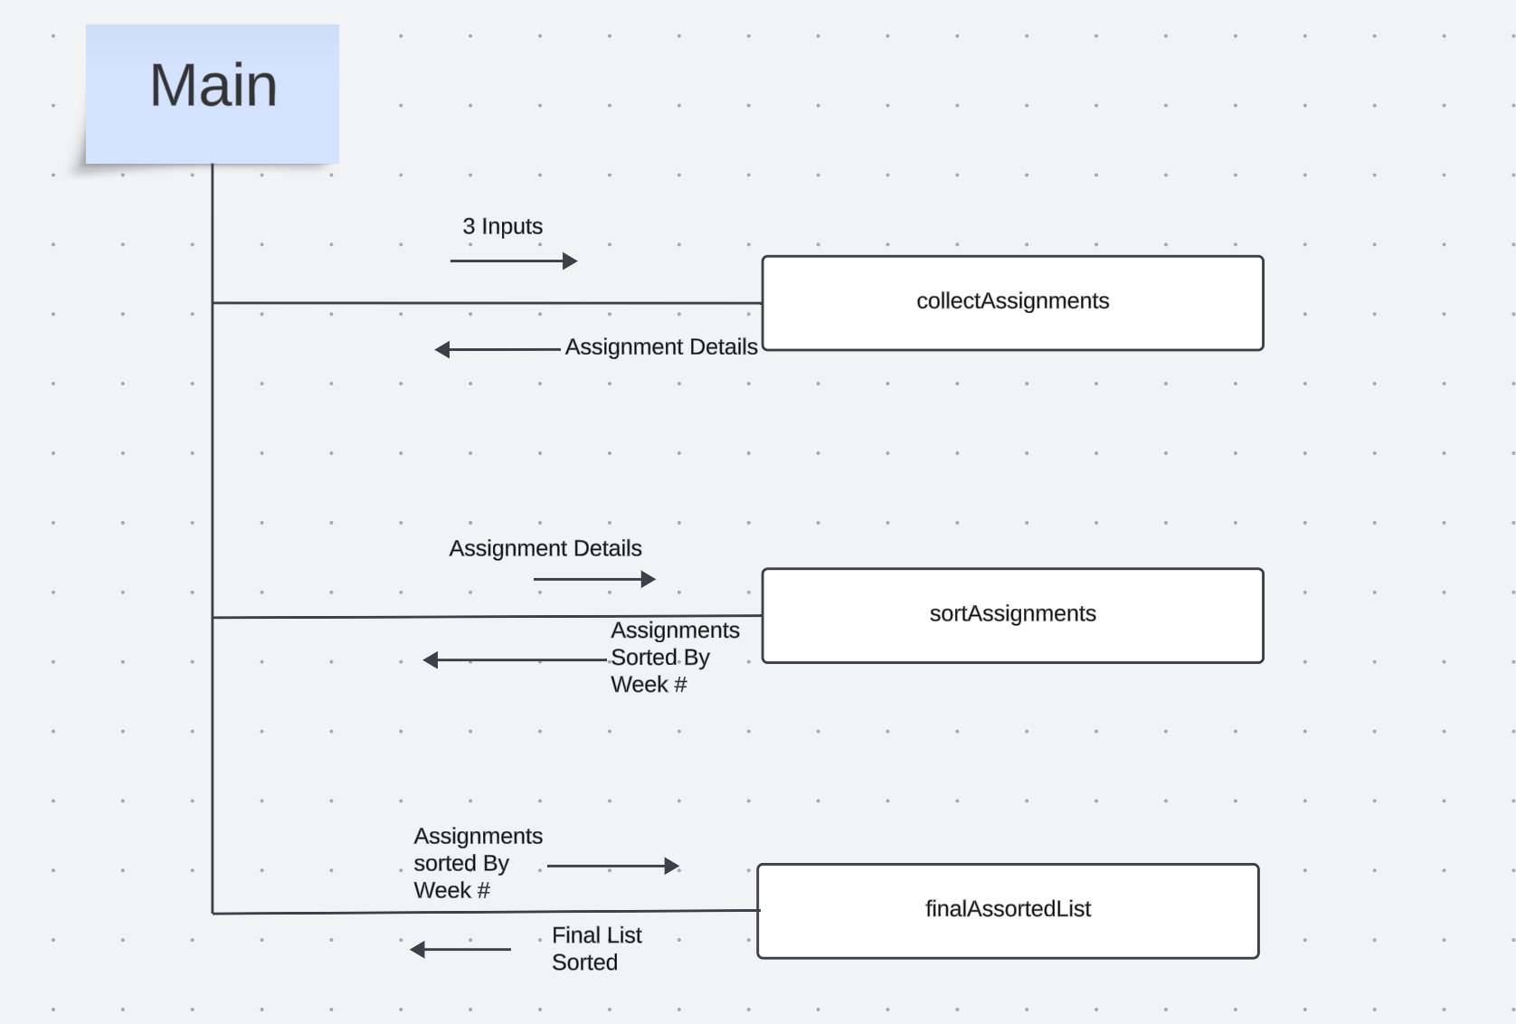
Chart Overview of Function’s Design
Notes:
As part of the main function, the collectAssignments function will collect assignment details:
Each assignment will have details including:
Assignment Name
Class Name
Week Due
Tool generates weekly plan displaying tasks for each week
Assignments are sorted in a list by week due having upcoming deadlines appear first
User can modify tasks at any time and planner will update

Slide 4
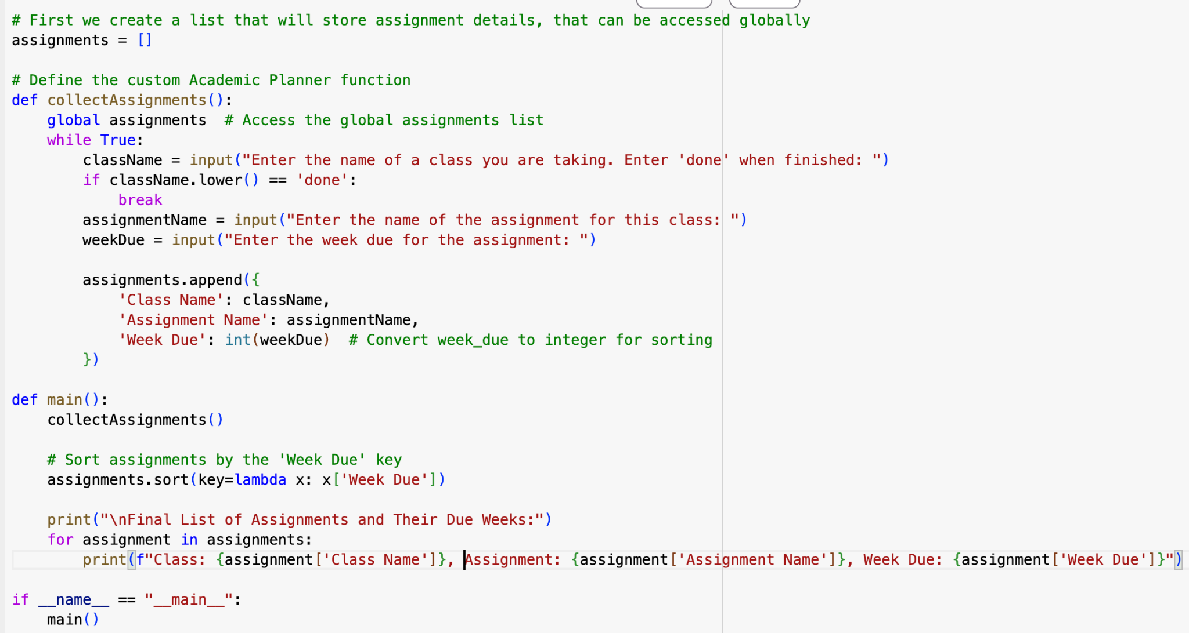
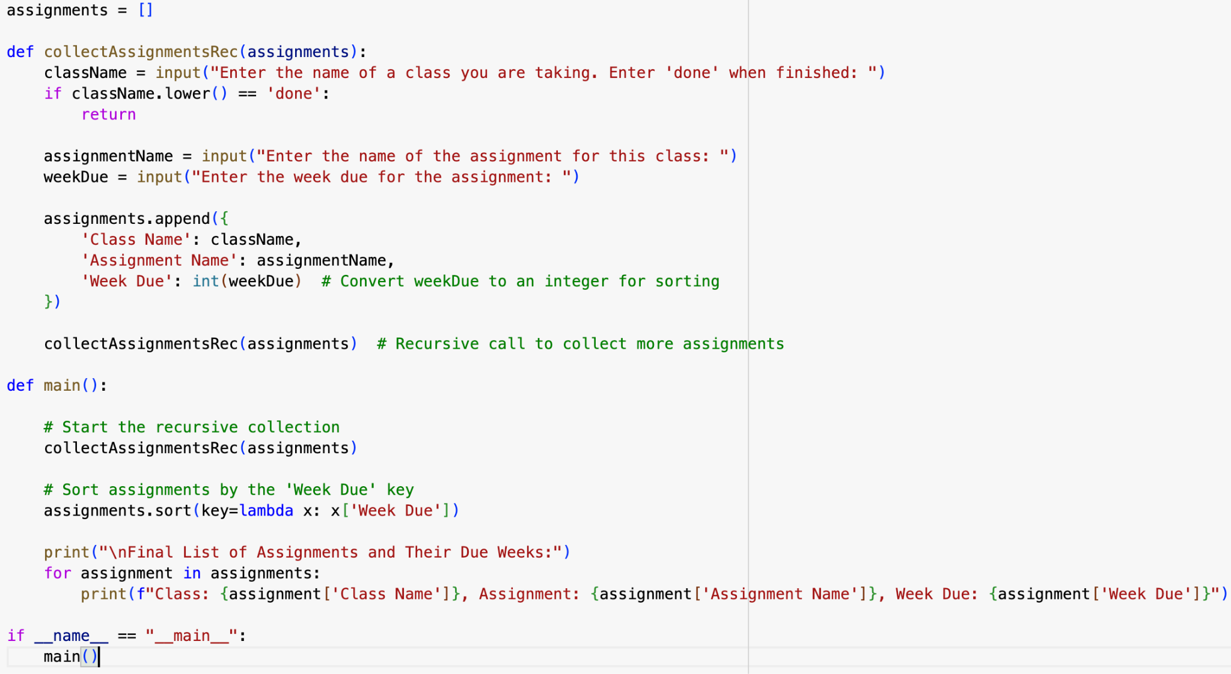
Regular Code Recursive Code
Uses “while True” statement
Sorts assignments by week
Stores in list
Function calls itself “collectAssignmentsRec”
Sorts assignments by week
Stores in list
Notes:
First, declare an empty list.
Recursive Call:
The function calls itself (collectAssignmentsRec(assignments)) at the end of its execution, allowing for continuous data entry until the user decides to stop by entering "done". This is the recursive element of the function, where it calls itself within its own definition.
Print Final List:
assignments: This is the list that contains all the dictionaries representing individual assignments.
for assignment in assignments:: This is a for-loop. Each iteration of the loop takes the next dictionary from the assignments list and assigns it to the variable assignment.
Each assignment is a dictionary containing the keys 'Class Name', 'Assignment Name', and 'Week Due'. Within the loop, each of these dictionaries is accessed and the corresponding values are printed, showing the class, assignment, and the week it's due.

Slide 5
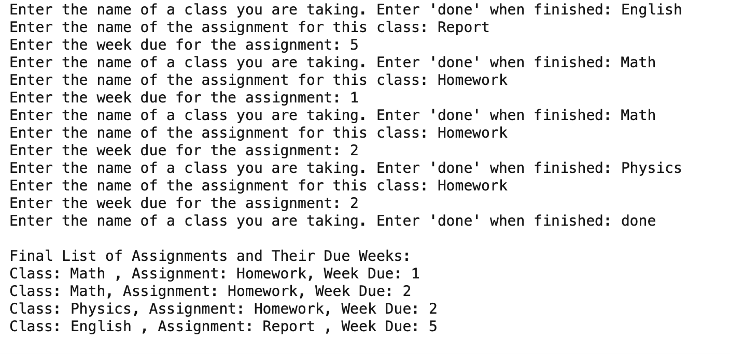
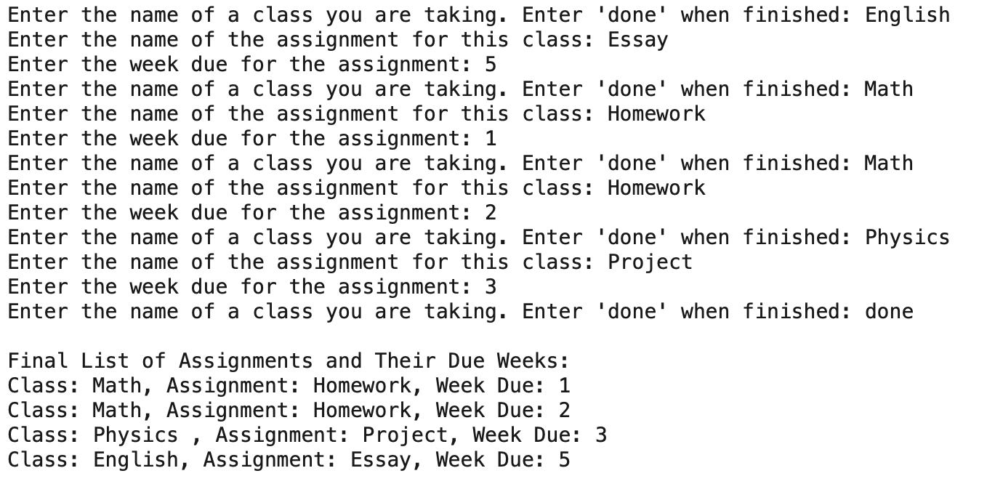
Testing And Validation
Regular Function
Recursive Function
More reliable and straightforward
If error occurs, entire code isn’t compromise
Less reliable if stack overflow occurs
More complex
Notes:
Recursive functions call on themselves indefinitely, so when there is an error it is likely to result in a stack overflow

Slide 6
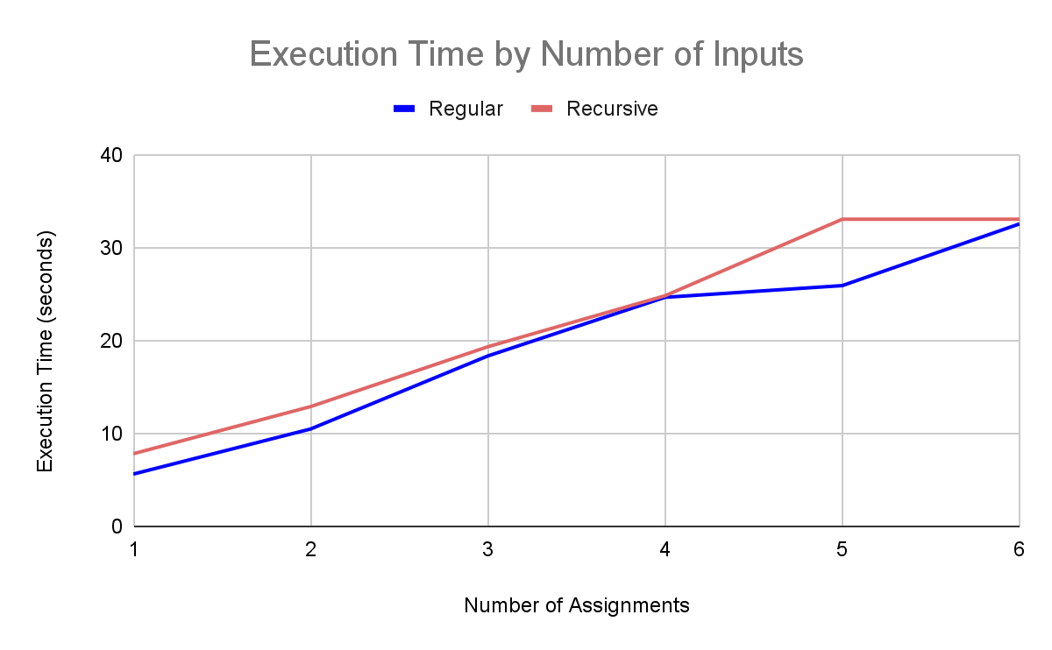
Performance Analysis
As expected,the regular function typically provided an output in slightly less time than the recursive function.
Note: The time it takes for the function to complete execution is highly dependent on the time it takes for a user to input the details of their assignments.

Slide 7
Conclusion and Recommendation
Both functions serve the same purpose of collecting, sorting, and displaying the information about the class assignments.
Recommendations
For this particular function, the iterative function would be recommended over the recursive function.
We would recommend the iterative because of its simplicity and efficiency.

Slide 8
THANK YOU!
Do you have any questions?

